Slide 1


Jan, 22 to Dec, 23
Business Report
Sales
SALES REPORT
PRESENTED BY
JATIN AGGARWAL
Understanding customer behavior to unlock profitable growth.
J.CALC.A

Slide 2




Introduction
02
INTRODUCTION
This report evaluates sales performance from Jan 2022 to Dec 2023, covering revenue, profit, and customer behavior.
Analysis includes customer demographics (age, gender), category performance, seasonal sales patterns, and time-of-day buying trends.

Slide 3
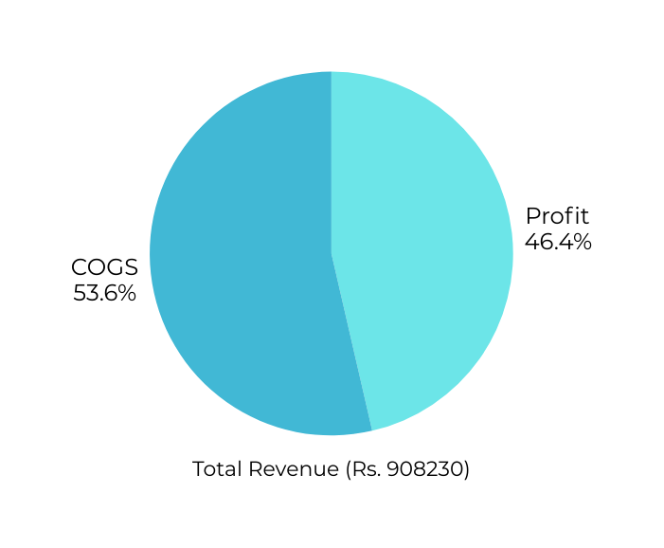




Overall Sales Report
03
Sales results for the year 2023 is quite stagnated. Based on the data that has been summarized, revenue have increased by 2.1% compared to the 2022.
OVERALL SALES REPORT
Total Revenue: Rs. 908230
Total Profi: Rs. 421368.95
This is a result that we should appreciate considering the tight competition with competitors.
Customers Reached: 155
Orders Delivered: 1987

Slide 4

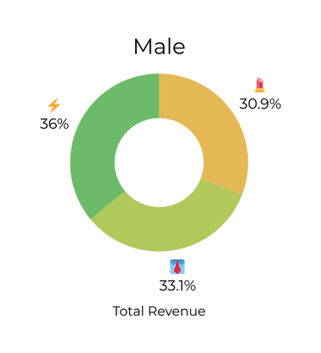

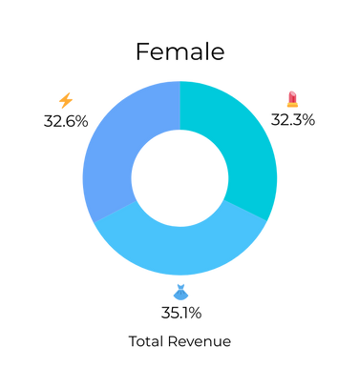
Consumer Demographics - AGE
04
GENDER BIFURGATION
FEMALE
MALE
Total Orders: 1012
Revenue: 463110
Avg Order Value: Rs 457.62
Hero Category: BEAUTY
Best Performing: CLOTHING
Total Orders: 975
Revenue: 445120
Avg Order Value: Rs 456.53
Hero Category: Clothing
Best Performing: Electronics

Slide 5
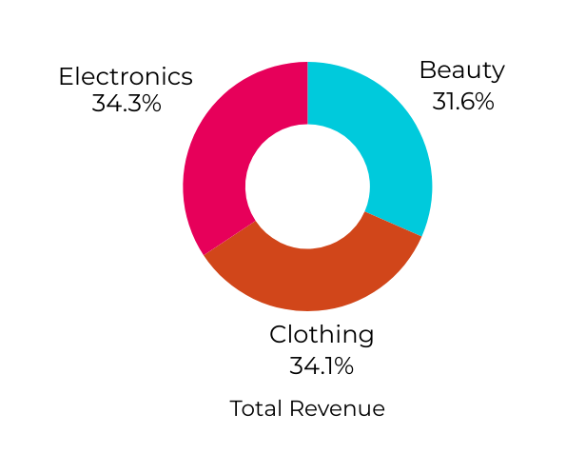
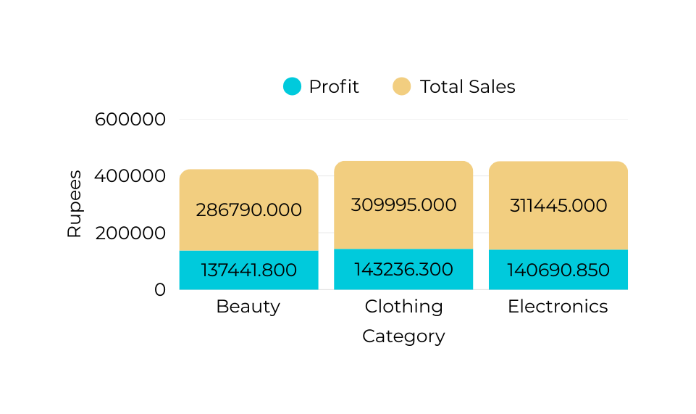
Categorical Performance
05
CATEGORICAL
PERFORMANCE
INSIGHTS
No dominant category: Revenue is spread almost equally, indicating diversified demand.
Clothing category has 47.39% profit margin - highest profitability

Slide 6
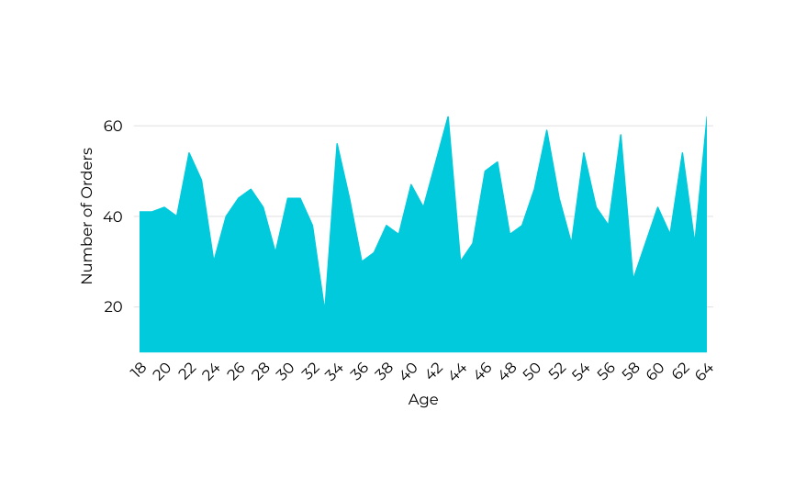
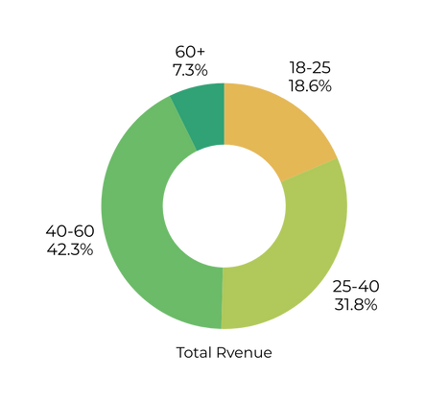
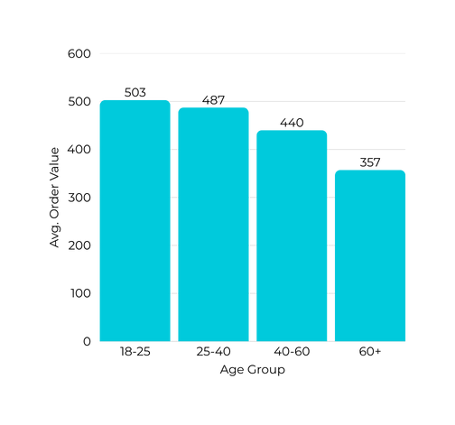
Consumer Demographics - AGE
06
AGE ANALYSIS
STRENGTH
OPPORTUNITY
42.3% of the total revenue is generated by the 40–60 yrs age group, with the majority of purchases concentrated in the Clothing category.
Untapped potential:
18–25 yrs show highest average spend (₹503/order) but generate only 18.6% revenue.

Slide 7
Consumer Demographics - AGE
07
18–25 yrs
25–40 yrs
AGE ANALYSIS
Potential
60+ yrs
40–60 yrs
Revenue
KEY OBSERVATIONS
IMPLICATIONS
18–25 yrs: Highest AOV (₹503) but only 18.6% revenue.
25–40 yrs: Strong segment (31.8%) with balanced spend & volume.
40–60 yrs: Highest revenue share (42.3%), mainly from Clothing.
60+ yrs: Smallest segment (7.3%) with lowest AOV (₹357).
18–25 yrs: High spending ability but low engagement → untapped growth opportunity.
25–40 yrs: Working professionals/families → ideal for upselling & lifestyle bundles.
40–60 yrs: Stable and loyal base → must be retained and expanded.
60+ yrs: Limited impact but potential for niche senior-focused offerings.

Slide 8
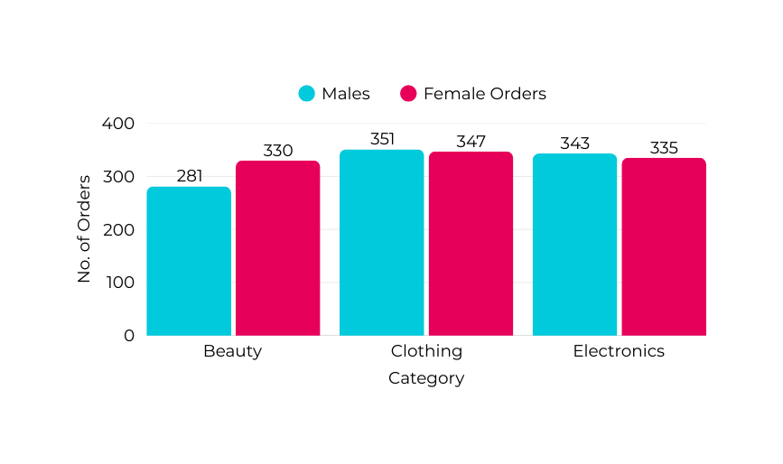
Category-Gender Relationship
08
CATEGORY-GENDER RELATIONSHIP
INSIGHTS
Beauty Category is dominated by Female customers.
Males are marginally ahead in the Clothing and Electronics categories.

Slide 9
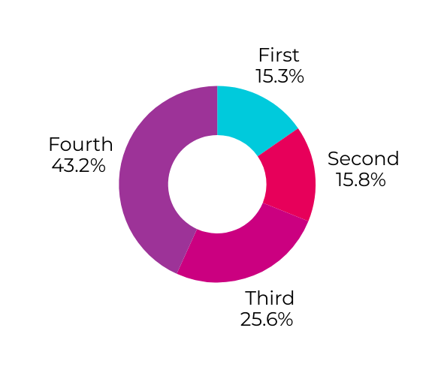
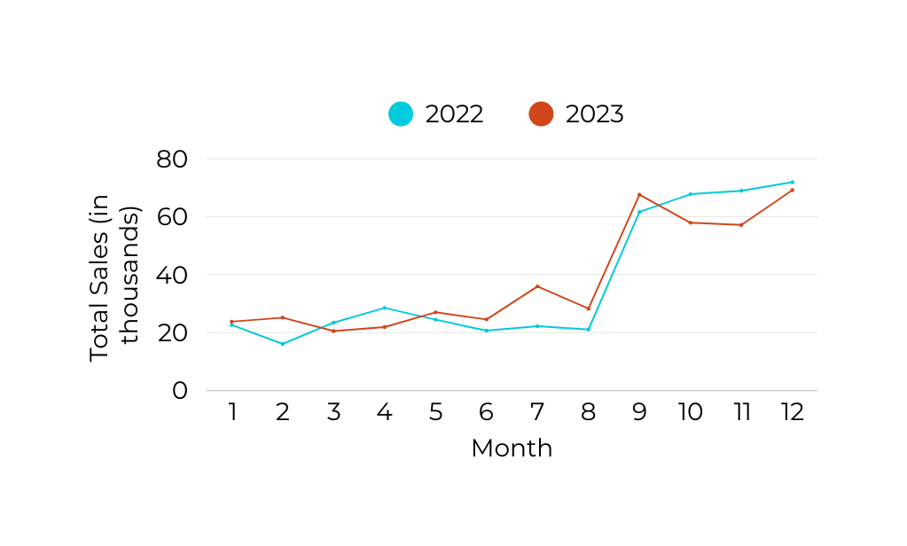
Seasonal Dependency
09
SEASONAL SALES TRENDS
INSIGHTS
Sales are heavily skewed toward Q4 (43.2%), leaving business vulnerable to festive dependency.
December month contribute most in both years
Q1 & Q2 (Jan–Jun): ~15% each → weak quarters, relatively flat demand.
Opportunity lies in Q1–Q2 demand generation and expanding Q3 build-up to balance annual revenue flow.

Slide 10
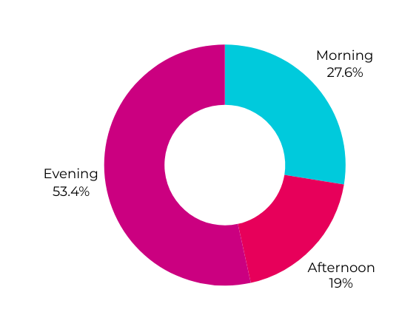
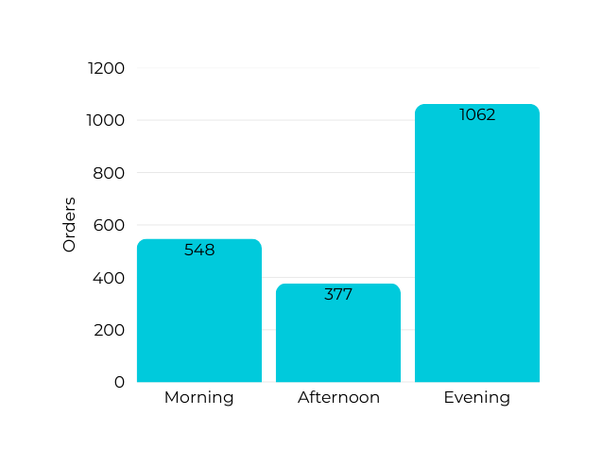
Active Shifts
10
TIME-DRIVEN SALES
TAKEAWAY
Evening is the prime shopping window - Customers are most active in evening, likely due to free time and mobile convenience.
Morning has potential → Active but not maximized; could be targeted with work-break or “start your day” promotions.
Afternoon slump - Indicates low engagement; customers are busy during this period.

Slide 11




Evaluation
11
EVALUATION
Customer Engagement: Low revenue from youth (18–25 yrs) despite high AOV; seniors remain under-served.
Although we have achieved a lot, it does not mean that there is no more room for evaluation. Here are some things that we need to improve, including:
Seasonal Dependence: Sales overly concentrated in Q4; Q1 & Q2 need activation strategies.
Order Timing: Evening orders dominate; afternoon remains weak.

Slide 12


Next Steps
12
Boost Youth Engagement (18–25 yrs)
Launch digital-first campaigns, influencer tie-ups, and student offers to increase order frequency.
Rebalance Seasonal Sales
Drive Q1–Q2 demand with clearance sales, loyalty programs, and new product launches.
Expand Q3 pre-festive campaigns to reduce over-dependence on Q4.
Optimize Order Timing
Introduce morning specials and lunchtime deals to activate underperforming slots.
NEXT STEPS

Slide 13



J.CALC.A
Thank You
13
THANK YOU

